Slide 1
Taking the Scary out of Scala
Anna-Maria Wykes
Data Engineering & Cloud Consultant

Slide 2

Who am I?
Senior Advancing Analytics Consultant
Data Engineering & Cloud
Over 14 years’ experience working in Software & Data Engineering, most recently working with Scala, Kafka and various cloud tech
BSc in Multimedia Computing & Business, and a HND in Visual Communication
@annawykes
anna-maria-wykes-31939454

Slide 3
What makes me tick?
Passion for Data and strive to bring the worlds of Software Development and Data Science closer together.
Helped to organize/run local Code Clubs
Organize and volunteer at local events
Other areas of interest include UX, and Agile methodologies

Slide 4
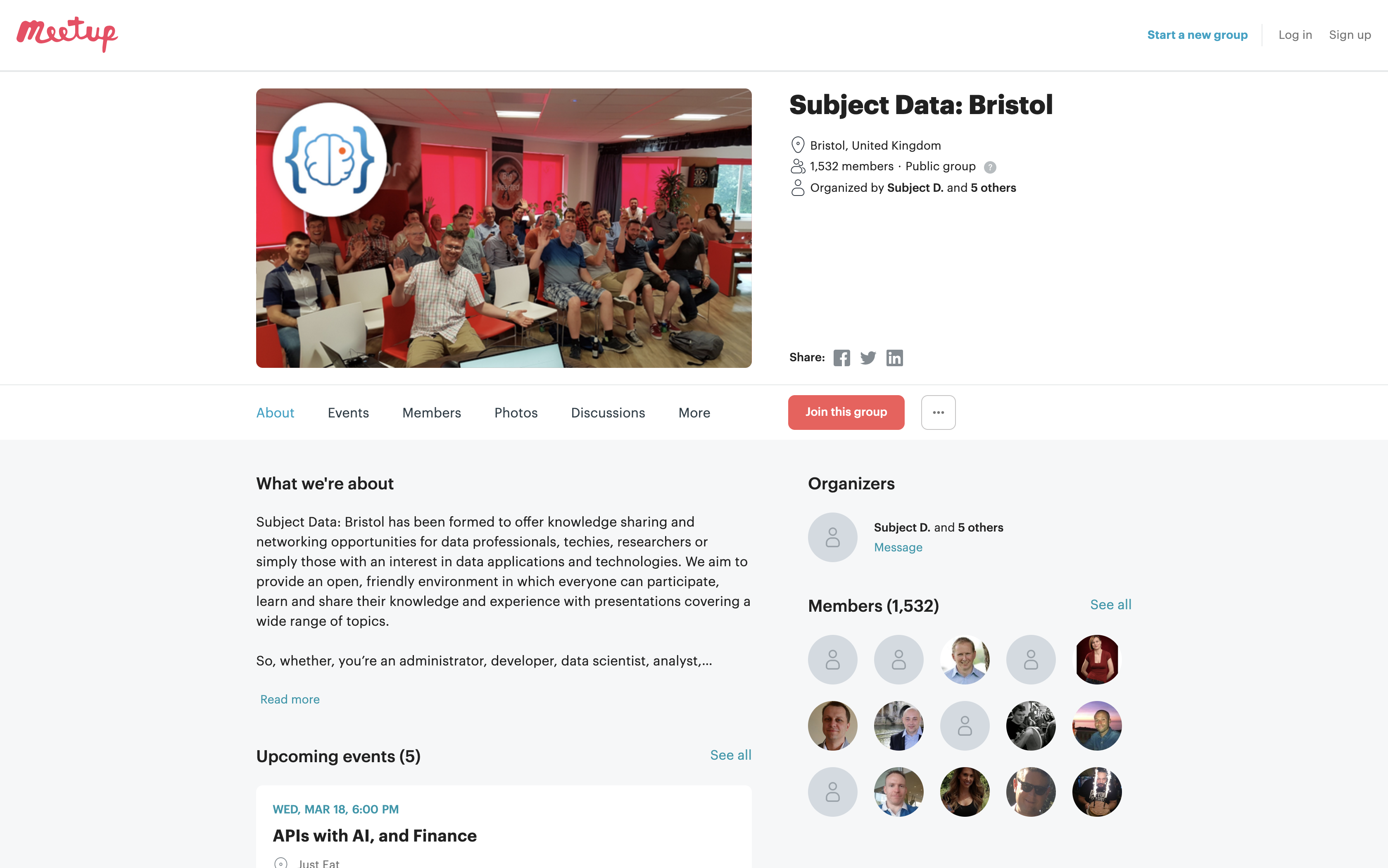
MEETups and Community Groups

Slide 5

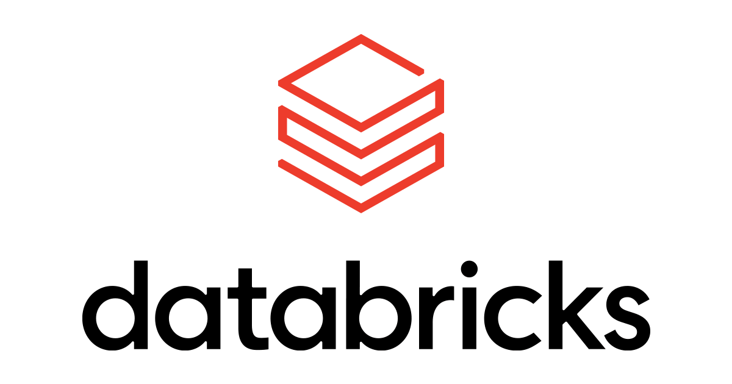

What are we going to do………

Slide 6
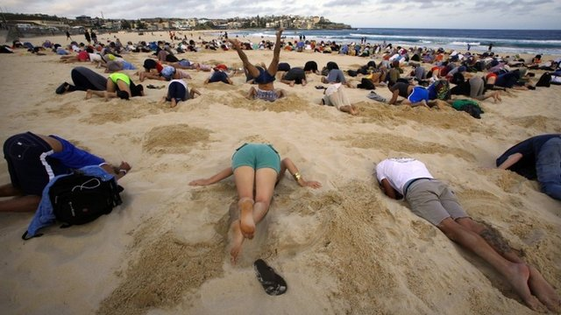
WHY?
Notes:
Spark & Databricks is written in Scala under the hood
inevitable you will have to work with Scala at some point
Libraries written in scala

Slide 8

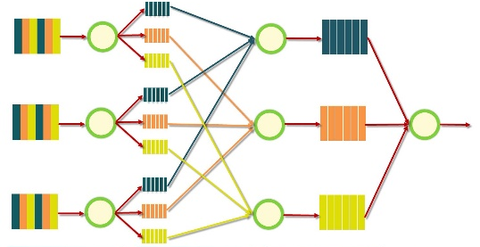



Google MapReduce Papers
2004
Google File System Papers Released
2006
2003
Databricks blurb
Apache Hadoop project created
Matei Zaharia starts Spark project
Project donated to Apache Foundation
Databricks founded by Matei and associates
2012
2013
2013
Notes:
Evolution of distributed storage
Evolution of Distributed compute
MapReduce = Java
Hadoop evolved from GFS
Matai Zaharia

Slide 9

What is Scala?
Object Orientated and Functional programming paradigms
What is Scala used for? A lot of things, ranging from
Machine Learning to Web Apps
The name Scala stands for “scalable language.” The language is so named because it was designed to grow with the demands of its users

Slide 11
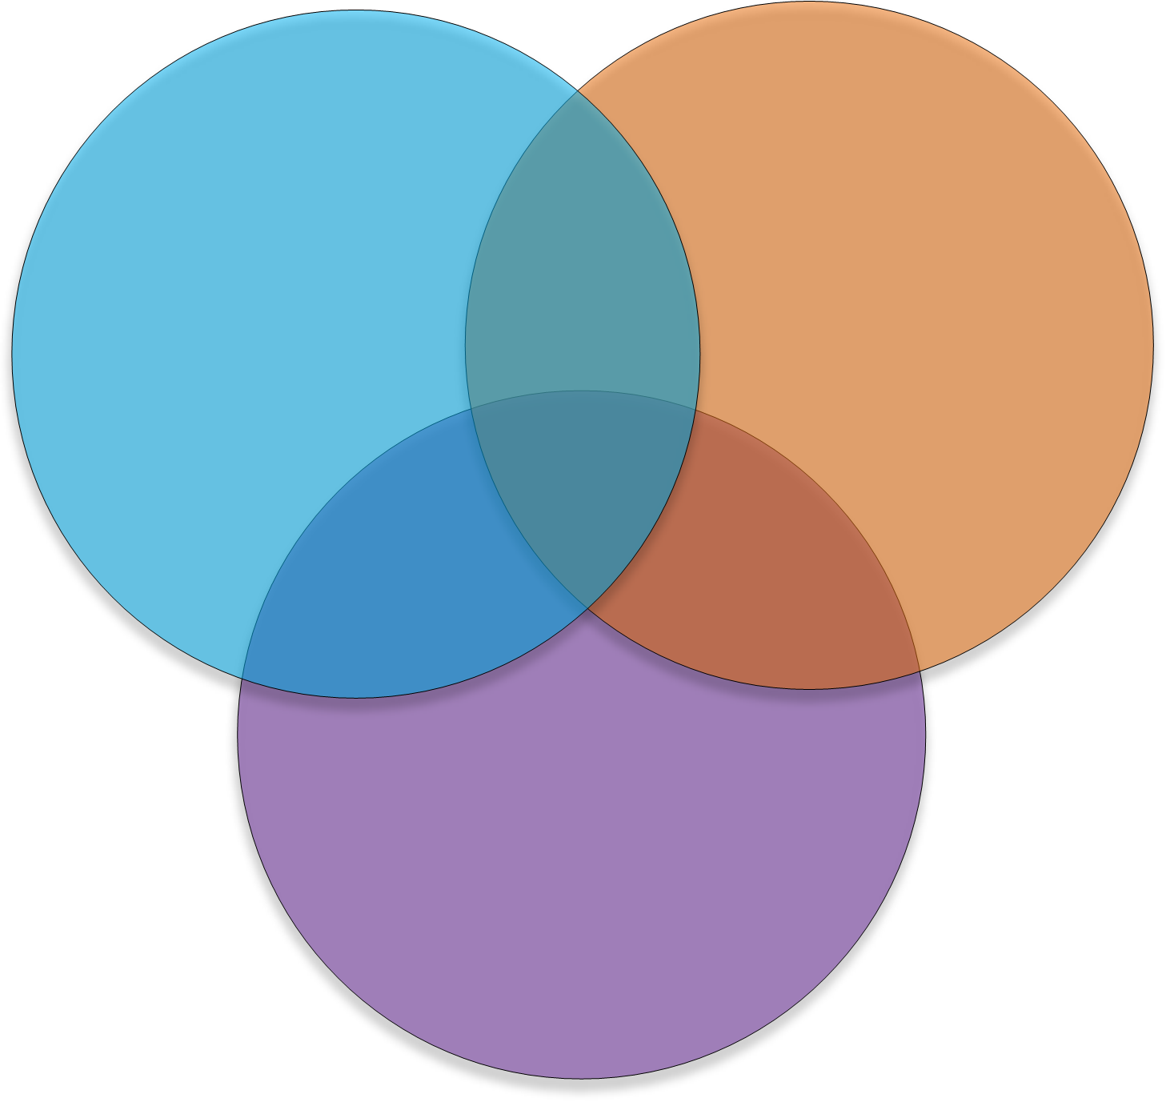
The ultimate teaching language?
Python
Java
Compilation
Procedural Programming
Static Types
OOP
Data Structures
Design Patterns
Interpreted
Dynamic Typing
REPL
C-Style
Functional Programming
JavaScript

Slide 12






Who Uses scala

Slide 13
Software written in scala

Slide 14
But still, why bother….
Notes:
Transferable, portable skills in their day job, Competitive skill set
Scala is multipurpose, meaning you can use if for anything from a simple web app to ML
Learn Functional Programming
It has a solid community behind it
It is Type safe

Slide 15
Types safety means you can’t turn a cat into a dog

Slide 16
Basics of Scala What are we going to look at?
Case Classes
Option
Pattern matching
Map & FlatMap
Fold, Reduce and Filter
For Comprehensions

Slide 17
Case classes

Slide 18
Case classes
Good for modelling immutable data Act like blueprints

Slide 19
OPTIONS

Slide 20
The NULL Mistake
“I call it my billion-dollar mistake. It was the invention of the null reference in 1965” — Tony Hoare, 2009

Slide 21
How does Scala handle Nulls: Options
A Scala Option holds zero or one element of a type. This means that it is either a Some[T] or a none object. One place we get an Option value is through the get() method for a Map
SOME = Something
NONE = Nothing

Slide 22
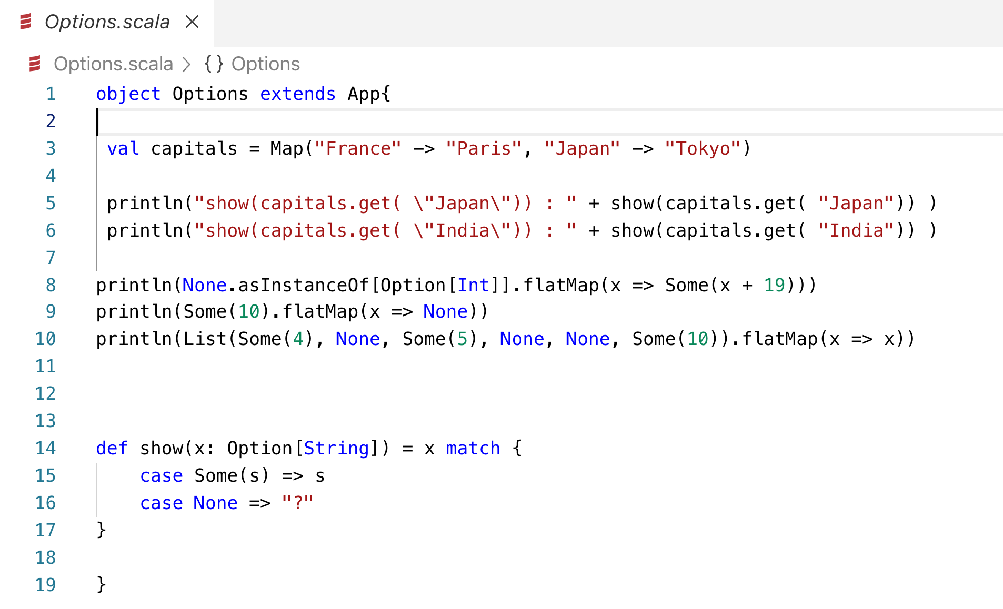

Slide 23
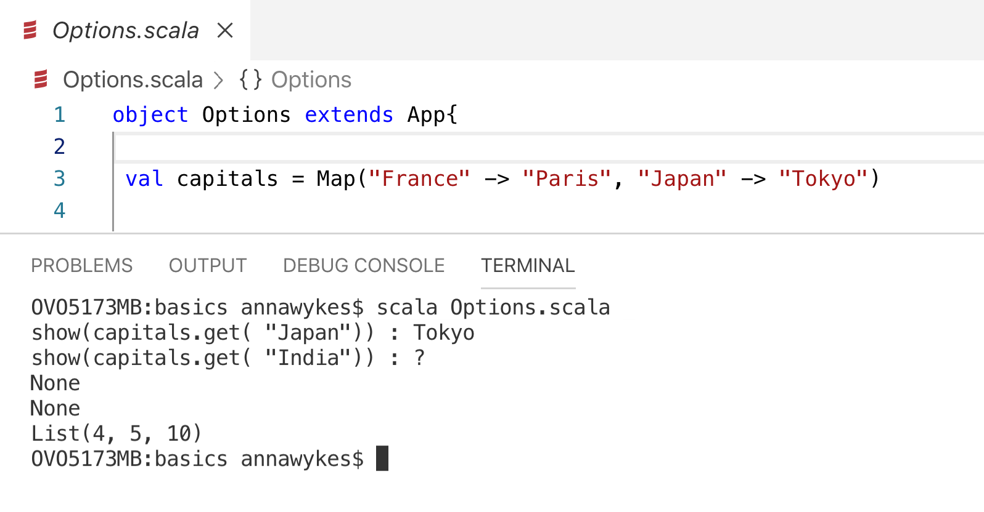

Slide 24
MAP

Slide 26
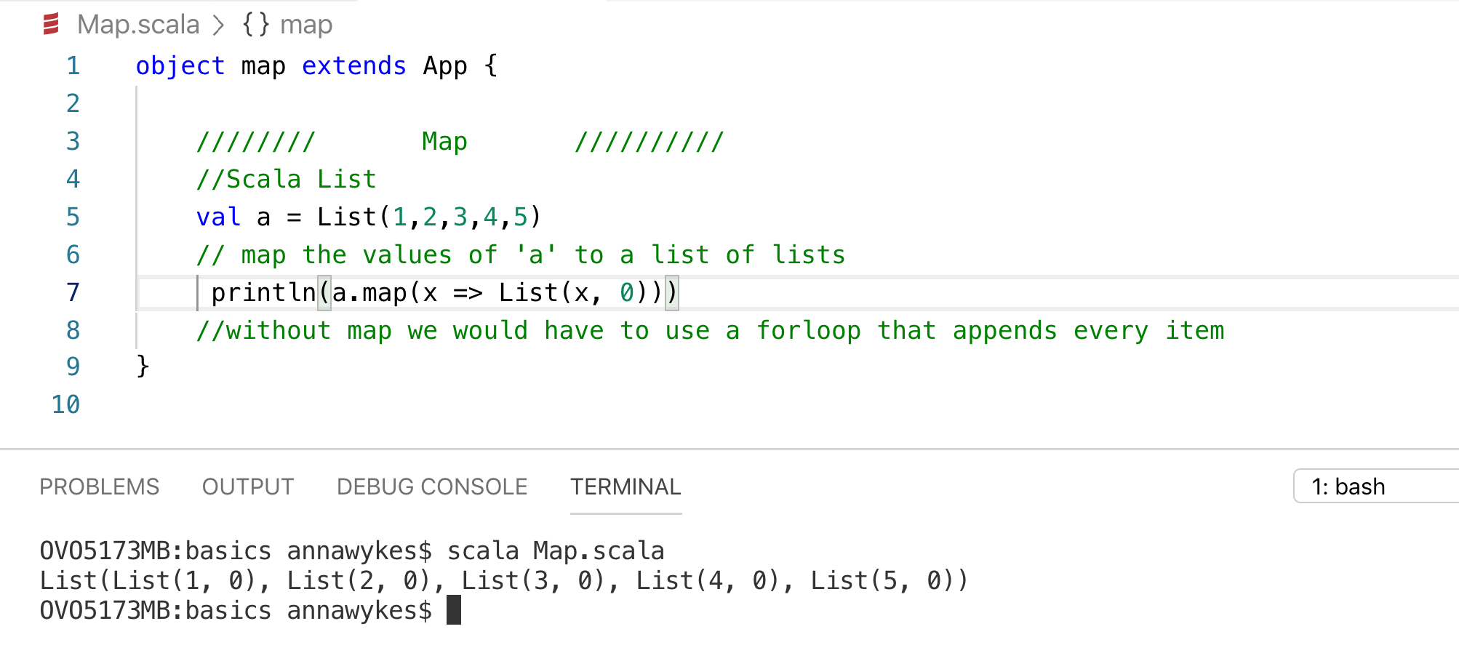

Slide 27
FLATMAP

Slide 28
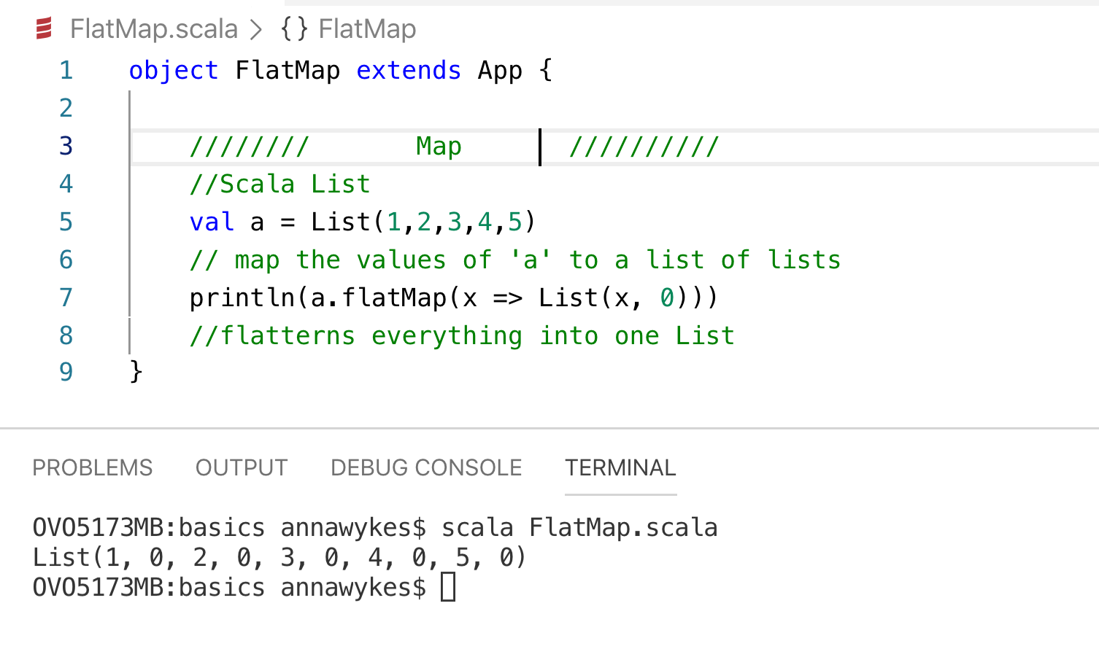

Slide 29
When you forget to use flatmap

Slide 30
FOLD REDUCE AND FILTER

Slide 32
FOR COMPREHENSION

Slide 33
Functional Programming: Monads
Step One
A Monad is a sequence of events with a get out of jail card
Step Two
Step Three

Slide 34
Useful links
Learning
https://www.scala-exercises.org/
https://scala.epfl.ch/
https://www.coursera.org/specializations/scala
https://typelevel.org/cats/
https://medium.com/disney-streaming/tagged/thisweekinscala
Conferences
https://scaladays.org/
https://scala.world/

Slide 35
THANK YOU
https://github.com/AnnaWykes/scala-for-big-data
anna-maria-wykes-31939454
@annawykes

